Slide 1

Epsilon Systems: Where Our Innovations Become Your Solutions
Corporate Overview
Notes:
Different graphic backgrounds can be created for use by various divisions, or for particular clients, as needed. Contact Lisa Ricciardulli – lricciardulli@epsilonsystems.com

Slide 2
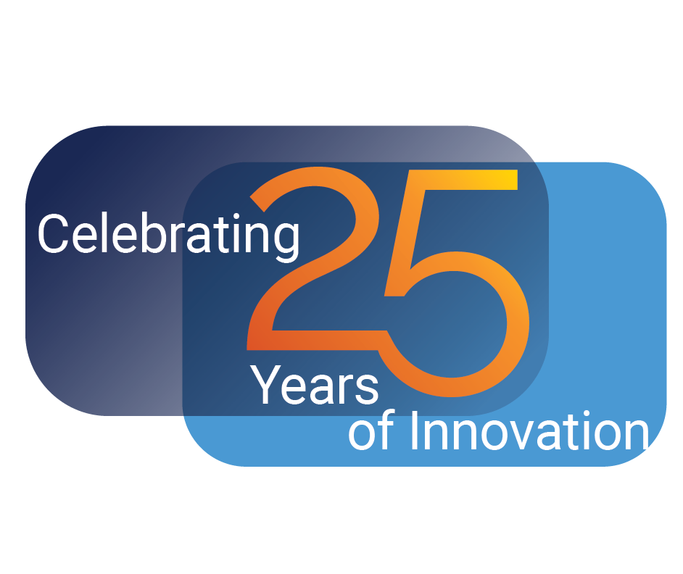
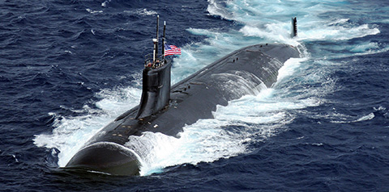

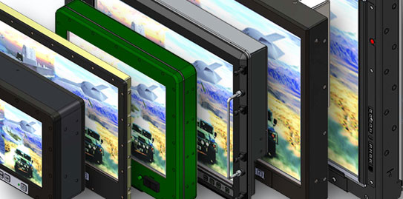
25 Years of Innovative Solutions
Ship Repair, Maintenance, and Modernization
Life-Cycle Engineering
C5I Software/Systems Engineering Services and Products
Specialized Product Engineering, Design, and Manufacturing
Learning, Development, and Training Solutions
GIS Mapping and Environmental Management Services and Software

Slide 3

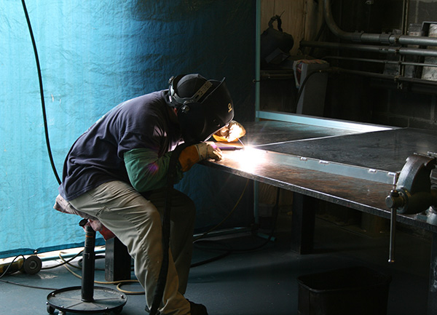
Epsilon Systems – A Trusted Partner
Diverse Professional and Technical Services Company
Founded in 1998
Consistent Organic Growth
Targeted Technology Acquisitions
Nearly 1,200 Skilled Professionals
Scientists/Engineers
Technical Specialists
Skilled Craftsmen
Up to TS/SCI Cleared Employees
Headquartered in San Diego
Top Secret Facility Clearance
Secret Collateral Facility in Largo, Florida

Slide 4
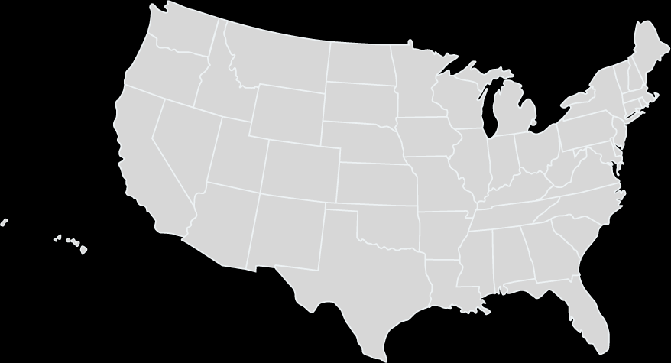
Epsilon Systems Office Locations
Philadelphia, PA
Dayton, OH
Chesapeake, VA
Portsmouth, VA
Ridgecrest, CA
St. Louis, MO
Headquarters: San Diego, CA
National City, CA
Albuquerque, NM
North Charleston, SC
Pearl City, HI
Las Cruces, NM
Jacksonville, FL
Largo, FL

Slide 5
Qualifications / Certifications
NAVSEA NOTE 5000 SUBSAFE Certified, on all classes of submarines
Designated Overhaul Point (DOP) for Submarine Corporate Component Repair Program (CCRP)
Master Ship Repair Agreement (MSRA) to perform Complex Repair Work (Virginia Location)
ISO 9001:2015-Compliant Quality Management Systems
NAVSEA and American Bureau of Shipping (ABS) Certified Welders and Non-Destructive Testing (NDT) Personnel
Certified Fiber Optic Technicians
Level III NDT Visual, Penetrant, Magnetic, and Ultrasonic Testing Provider
ISO
9001:2015
SUBSAFE
NAVSEA AIT
Notes:
Updated 5/25/22

Slide 6
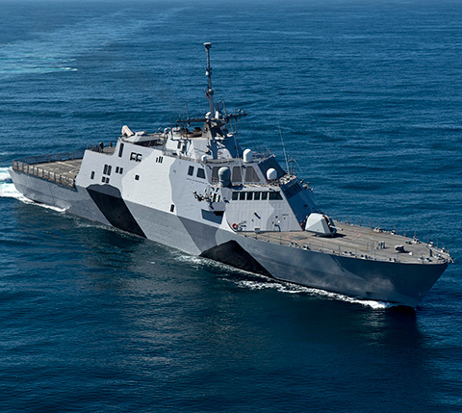
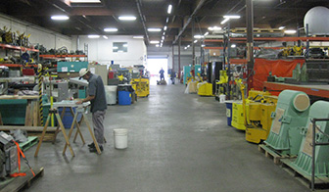
Worldwide Ship Repair and Modernization Support
Nuclear submarines, surface ships and aircraft carriers
Primary Customers
Naval Sea System Command (NAVSEA)
NAVSEA Field Activities
Private and Naval Shipyards
Industry Primes and Partners
Epsilon Systems Repair and Modernization Facility Locations
Portsmouth, VA
San Diego, CA
Pearl Harbor, HI
Mayport, FL
Epsilon Systems personnel work in public and private yards
Fly-away teams support OCONUS locations, for example:
Singapore, Japan, Persian Gulf, Guam
Epsilon has a $200M contract to provide LCS 1 Class Planned, Preventative and Facilities Maintenance for Mayport, FL based ships.

Slide 7
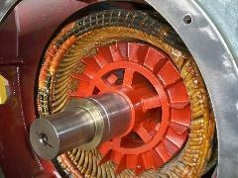
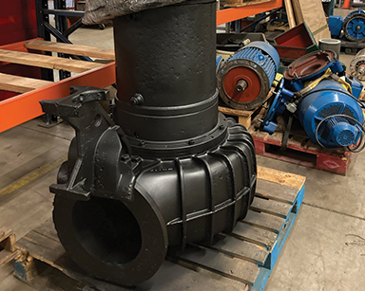
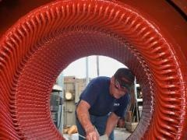
Industrial and Shipboard Electrical
Full Range of Shipboard Electrical Services
Generator Cleaning and Refurbishment
Pump-Motor Combinations
Removal, Refurbishment and Reinstallation
Electric Motor and Control Products
Adjustable Speed Drives
Electric Motors
Programmable Logic Controllers (PLCs)
Power Transmission
Customers include electrical power generation plants, hospitals, municipalities, water districts, mechanical contractors, manufacturers, food producers, and ship repair customers such as the U.S. Coast Guard and the U.S. Navy.

Slide 8
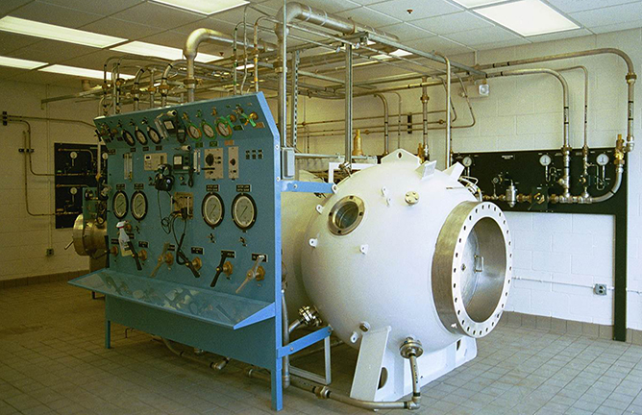
Hyperbaric Systems
Over 20 years’ experience manufacturing hyperbaric and diver life support systems
Contract/project execution supported from design phase to final product
Air pressurization, breathing systems (air and oxygen), fire extinguishing, etc.
Oxygen clean various products including hoses, components, piping systems, etc. to MIL-STD-1330/MIL-STD-1622
Class 10,000/ISO 7 equivalent cleanroom to support this capability

Slide 9


C5I Software/Systems Engineering Services and Products
We integrate extensive data sets to provide actionable intelligence for rapid, accurate decision making
Software Engineering – Design, Solutions, Support
SIGINT/IO/ISR Architecture, Engineering, Testing, Validation, and Installation
Digital Signal Processing
Web/Cloud Services Development
Networking Engineering/Application Integration
SIGINT Operational Training Support
Cybersecurity Engineering
Requirements Engineering

Slide 10
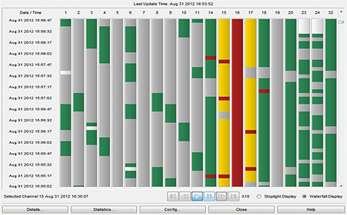
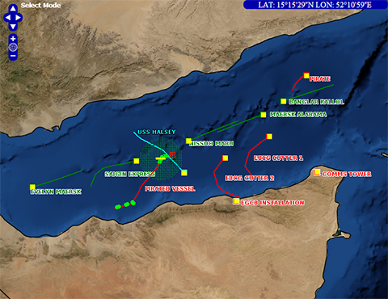
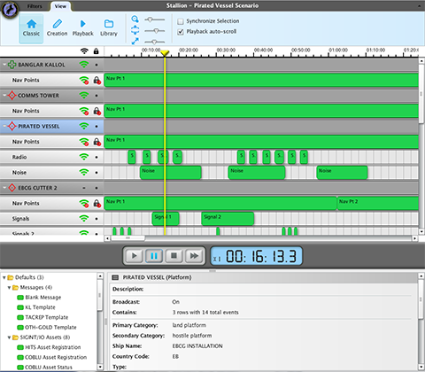
C5I Services
Software Engineering Design, Solutions, and Support
DevSecOps
C5I Architecture, Engineering, Testing, Validation, Installation
Web/Cloud Services Development
Digital Signal Processing
Network Engineering/Application Integration
Cybersecurity Engineering and Management
Operational Training Support

Slide 11
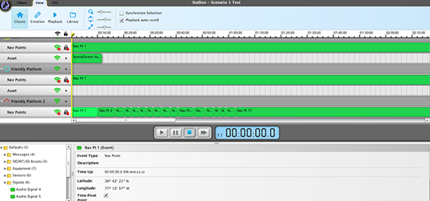
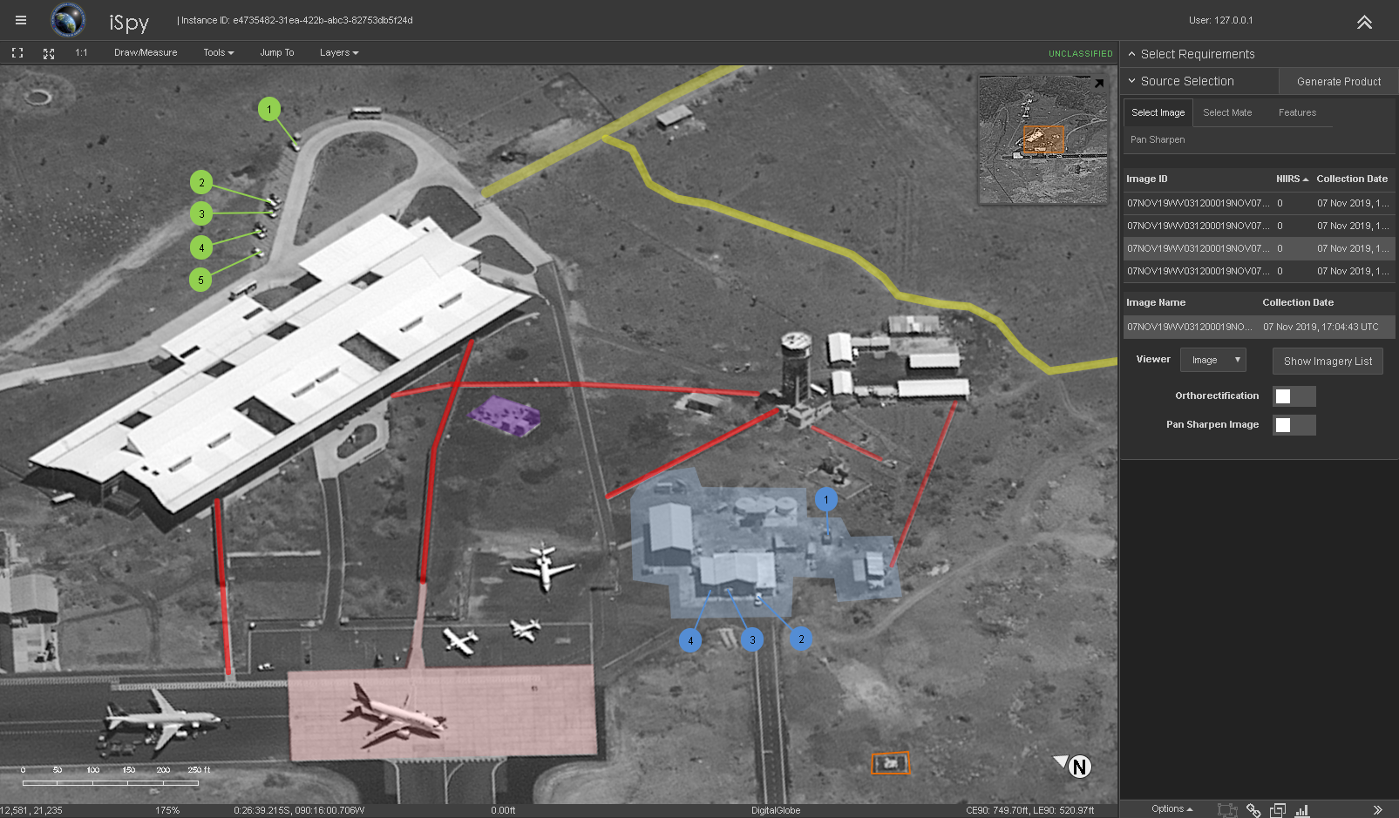
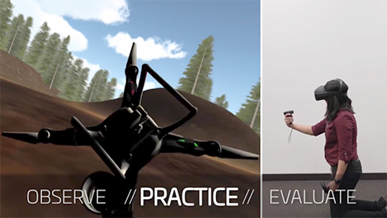
C5I Products
Automation Solutions/DevSecOps – TAF
Simulation/Stimulation Training, including portable training – Pegasus and Maestro
Imagery Exploitation/Targeting Workflows – CGS Web/iSPY
Virtual and Augmented Reality (VR/AR) for Training
Mission Compatibility Analysis Tool (MCAT)
Training and Employee Development Solutions

Slide 12
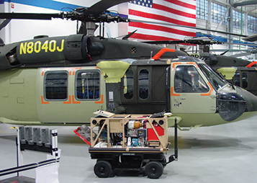
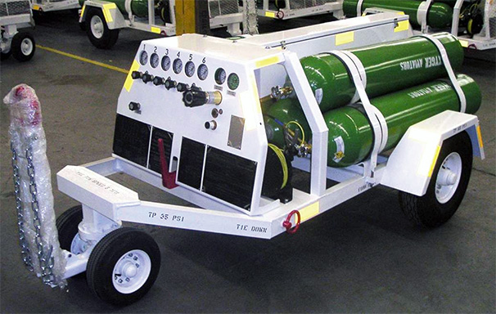
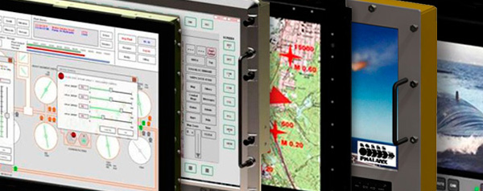
Advanced Products
Design, Assembly, and Testing of Electrical, Mechanical, and Electronic Assemblies for commercial and military applications
Ground Support Equipment for domestic and international aircraft
Compact Aircraft Support Cart (CASC)
Aircraft Oxygen Servicing Carts
Rugged Flat Panel Displays for use in combat systems (land and subsurface)
From 10.4” LED to 24” High-Definition Panoramic
Wide Range of Qualifications (Noise, Shock, Vibration, EMI)
ISO 9001-2015 Certified Quality Management System

Slide 13
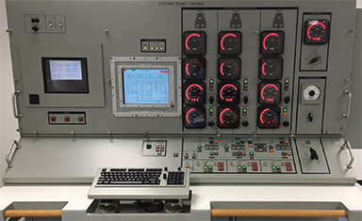
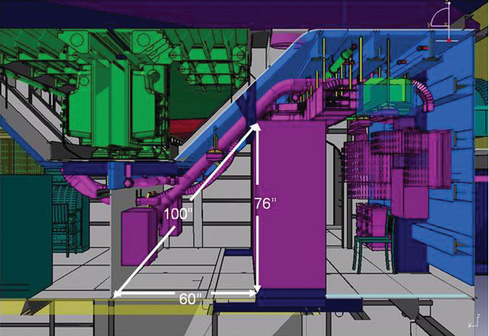
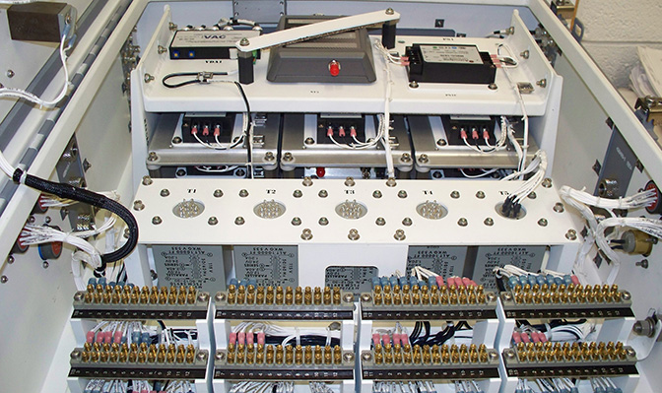
Advanced Products Manufacturing
Compliant with rigorous military operational and reliability standards
ISO 9001:2015 Full Design Quality Management System
Electronic rack build to print, assembly, and fabrication
Junction box build to print, assembly, and fabrication
Wire harness design, assembly and fabrication
Training equipment design and manufacturing (surface, subsurface, and aviation)

Slide 14
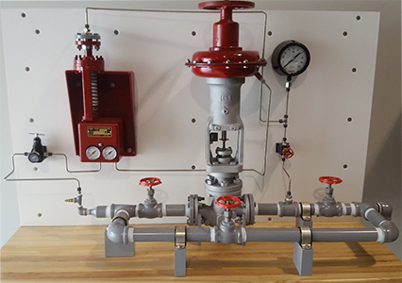
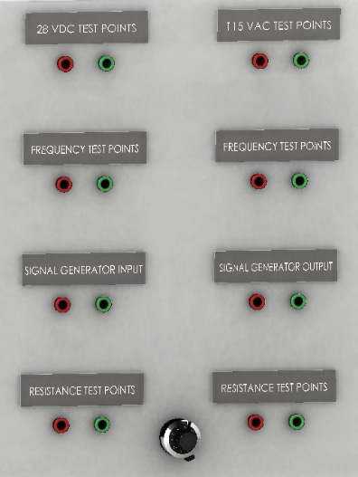
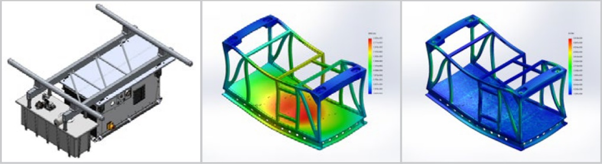
Advanced Products Services
Custom Training Equipment Design and Assembly
Partial Task Trainers (PTT)
Technical Training Equipment (TTE)
Build to print (BTP)
Contract manufacturing
Laser etching and marking
Engineering test plans
Mechanical and electrical test plans
Design and development of test fixtures and systems
SOLIDWORKS models for concept, prototyping, detailed design and manufacturing

Slide 15
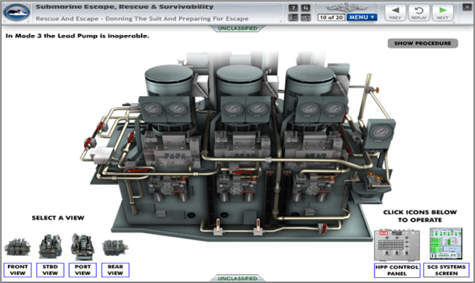
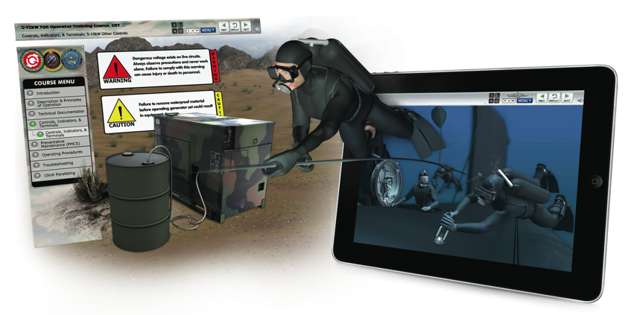

Training Development Capabilities
Solutions Across the Entire Learning and Development Spectrum
Training analysis (JTA, FEA, competency modeling, etc.)
Instructional systems/curriculum design and development
SCORM/AICC/Section 508 compliance expertise
Online training using courseware development suites
Software simulation – virtual/augmented reality
Training delivery
E-Learning / distance learning
Instructor-led training
Evaluation, certification, and assessment
Course conversion
Learning Management System (LMS) integration and performance tracking
Training facilities design and build

Slide 16

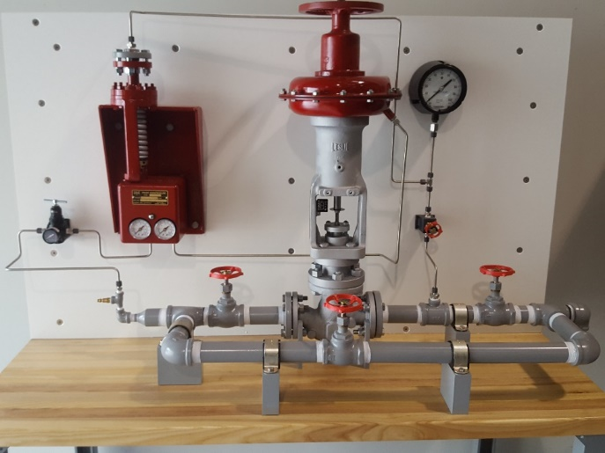
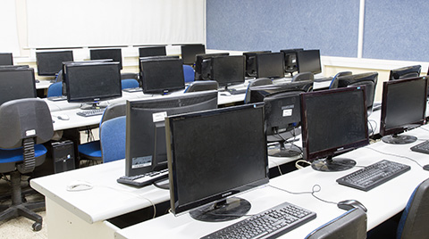
Accelerated Training through Digitization and Aids
Virtual/Augmented Reality (VR/AR)
Physical Training Environments
VR/AR is immersive learning in a controlled, realistic training environment to safely learn skills and procedures. Training systems are built upon:
Simulation/Stimulation
Virtual Task Trainers (VTT)
Virtual Training Aids (VTA)
Virtual Reality (VR)
Augmented Reality (AR)
Multiple Player VR
Design and manufacture of custom training equipment to give students hands-on experience.
Partial Task Trainers (PTT) for classroom
Physical training aids
Full trainers with alternative materials
Technical Training Equipment (TTE)

Slide 17
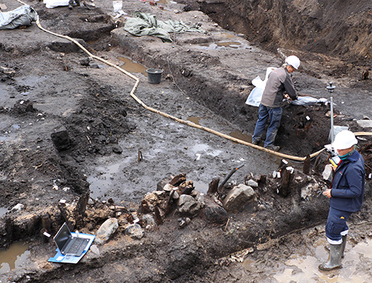

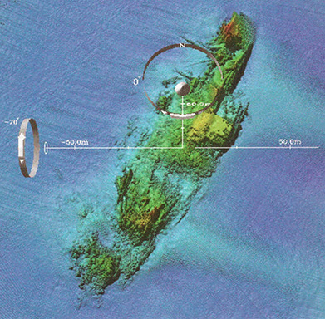
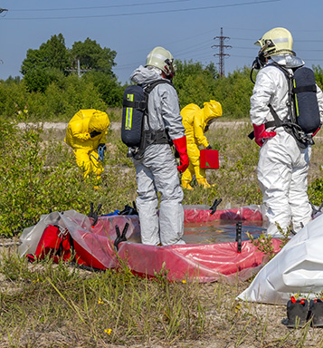
Environmental Services
Site investigation, regulatory compliance, and environmental management
Cultural Resources
Natural Resources
Geographic Information Systems (GIS) Systems
Remedial Investigation Services
National Environmental Policy Act (NEPA) Documentation

Slide 18


Environmental and Range Support
Epsilon Systems Environmental Compliance team supports:
Naval Air Warfare Center Weapons Division in China Lake
Nearly one million acres of Navy-owned lands within the remote Mojave Desert
36,000 square mile Sea Range at Point Mugu, California, including San Nicolas, and portions of Santa Cruz and San Miguel Islands
Naval Air Station Patuxent River Complex, Maryland
13,800 acres of facilities
White Sands Missile Range
NEPA Documentation
Natural and Cultural Resources

Slide 19
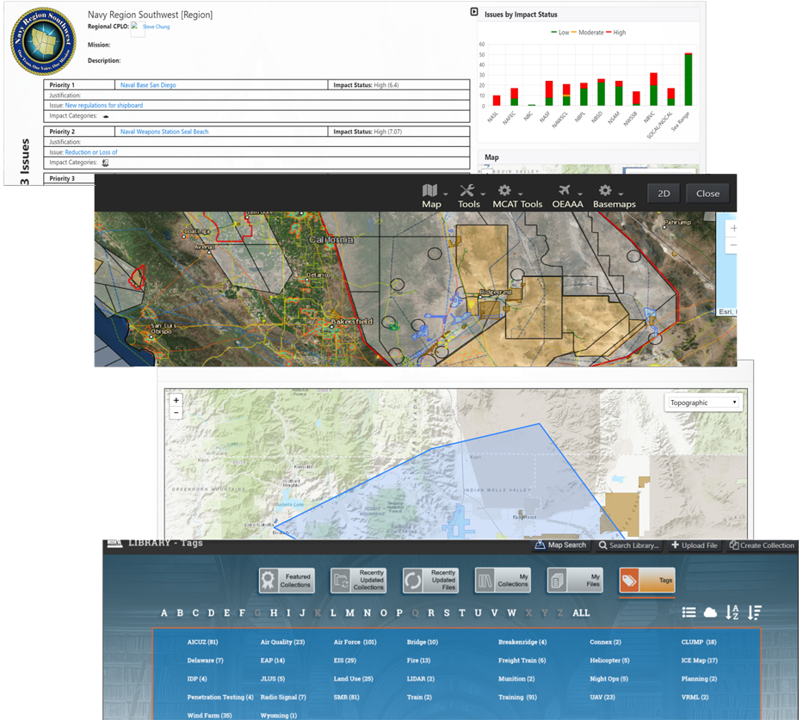



Mission Compatibility Analysis Tool (MCAT)
GIS mapping with dynamic overlays for mission planning
U.S. Navy’s enterprise encroachment tool for natural resources
Used to evaluate, document, and communicate potential military-mission encroachments
Assists decision makers in forming an authoritative preliminary assessment
Promotes collaboration and systematic evaluation of courses of action
Hosted in the Navy Amazon Web Services (AWS) GovCloud, and available for DoD-wide use
Extended to the states of California, Oregon, and Washington as a wind turbine encroachment tool
Great potential for expanded use of GIS/dynamic overlays for mission planning
Create inclusion and exclusions zones

Slide 20
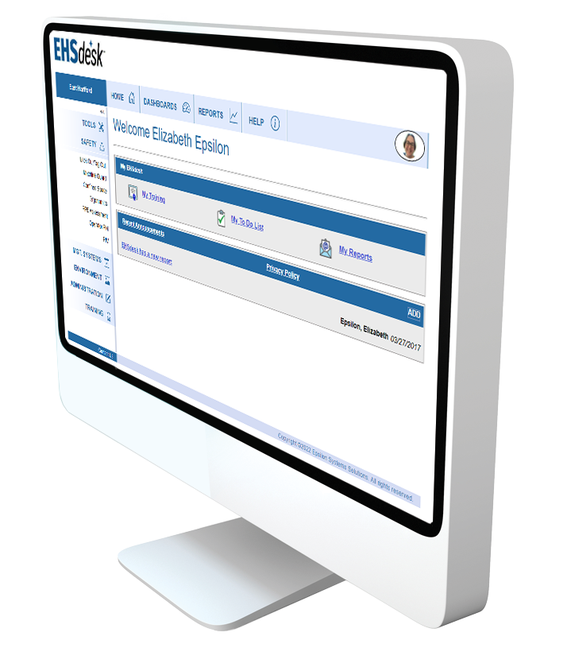
EHSdesk: Environmental, Health & Safety Compliance Software
Comprehensive Suite for EHS Compliance, Tracking and Reporting
Safety Applications: Lock Out/Tag Out, Confined Space, Shop and Office Ergonomics, Machine Guard, Operator PM, Powered Industrial Vehicle, and PPE Assessment
Management Systems Applications: EHS Management of Change, Corrective Action Request, Action Tracker, Incident Tracker, Risk Assessment/Industrial Hygiene, Audit & Inspection Management, and Virus Tracking
Environment Applications: Waste Tracker, Material Tracker, Regulation Manager, Equipment Characterization, Sample Tracker, Air Emissions, and Water
Automates requirements management and reporting process
Compliant with OSHA and ISO in tracking and producing automated reports

Slide 21
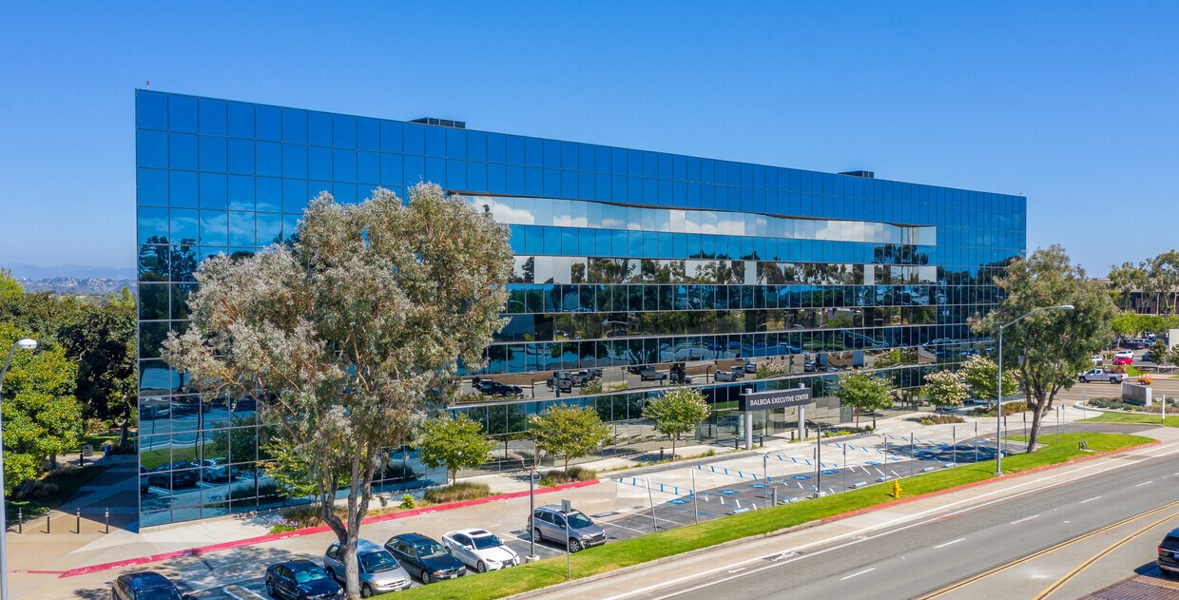
Why Epsilon Systems?
Proven Performance
Experienced and capable professionals with a clear focus on customer success
Responsive
Reliable, flexible and ready when called
Quality
Approved/certified quality management systems
Integrity
A values-based company

Slide 22

Questions?
Thank You

